Slide 1
Numerical Analysis
Bisection Method
Lab6

Slide 2
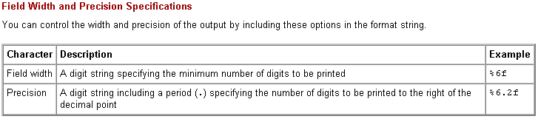
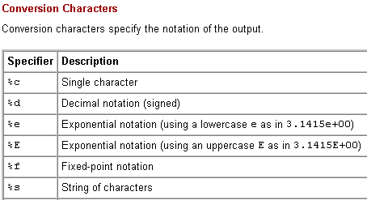
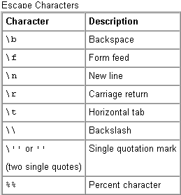
Functions used in Bisection
fprintf used to show formatted output

Slide 3
fprint function examples
>> a=2;b=3;c=5;
>> fprintf('a = %d , b = %d, c = %d', a, b, c);
a = 2 , b = 3, c = 5
>> fprintf('a=%d , b=%d', a, b);fprintf(‘\ta+b=%d ', a+b);
a=2 , b=3 a+b=5
>> fprintf('a=%d , b=%d \n', a, b);fprintf('a+b=%d ', a+b);
a=2 , b=3
a+b=5

Slide 4
fprint function examples
>> a = 3.7; b=3;
>> fprintf('a=%d , b=%d \n', a, b);fprintf('a+b=%d ', a+b);
a=3.700000e+000 , b=3
a+b=6.700000e+000
>> fprintf('a=%f , b=%d \n', a, b);fprintf('a+b=%d ', a+b);
a=3.700000 , b=3
a+b=6.700000e+000
%8 chars are used by %f as default

Slide 5
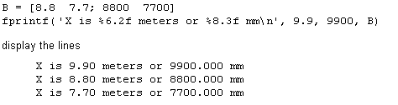
fprint function examples

Slide 6
Bisection
Following formula is used to find the maximum number of iteration
max1=1+round((log(b-a)-log(delta))/log(2));
Addition of 1 is to ensure that the tolerance is achieved before number of iteration is completed.

Slide 7
PROGRAM bisect.m
function [k,c,err,yc]=bisect(f,a,b,delta)
%Input - f is the fun - delta is the tolerance - a and b are the left and right endpoints
%Output - c is the zero - yc= f(c) - err is the error estimate for c
ya=feval(f,a); yb=feval(f,b); c=(a+b)/2; err=abs(b-a); yc=feval(f,c);
if ya*yb>=0
fprintf('The root is not lying in interval')
return
end
max1=1+round((log(b-a)-log(delta))/log(2));
fprintf('\t\t\tLeft\t\t\t\t\t\t\tRight\t\tFun Value\n')
fprintf('k\t\t endpoint\t\t Midpoint\t\t\tendpoint\t\tf(c)\n')
for k=1:max1
c=(a+b)/2; yc=feval(f,c);
fprintf('%d \t %15.8f\t%15.8f\t%15.8f\t%15.8f\n',k,a,c,b,yc);
if yc==0
a=c; b=c;
elseif yb*yc>0
b=c; yb=yc;
else
a=c; ya=yc;
end
if b-a < delta, break, end
end
c=(a+b)/2; err=abs(b-a); yc=feval(f,c);

Slide 8
Bisection Example 1
Define a function in cosmx.m file
  function y=cosmx(x)
  y=cos(x)-x;
Draw the graph of f(x)=cos(x)-x in command window.
>> fplot(‘cosmx', [-pi pi])
>>grid on
The root is lying in the interval [0 1]

Slide 9
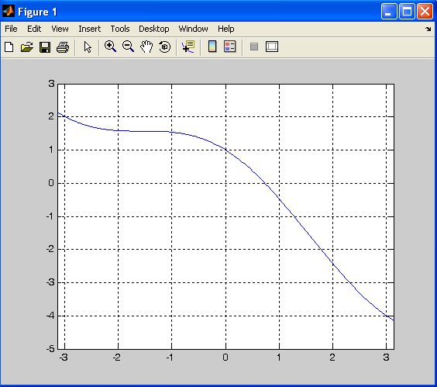

Slide 10
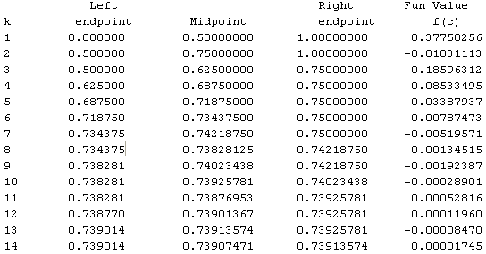
Bisection Example 1
>> [k, c,err,yc]=bisect('cosmx',0,1,1e-4)
k = 14
c = 0.7391
err = 6.1035e-005
yc = -3.3625e-005

Slide 11
Bisection Example 2
Define a function
  function y=xsinm1(x)
  y=(x*sin(x))-1;
Draw the graph of f(x)=cos(x)-x in command window.
>> fplot(‘xsinm1', [0 2])
>>grid on
The root is lying in the interval[1 1.2]

Slide 12
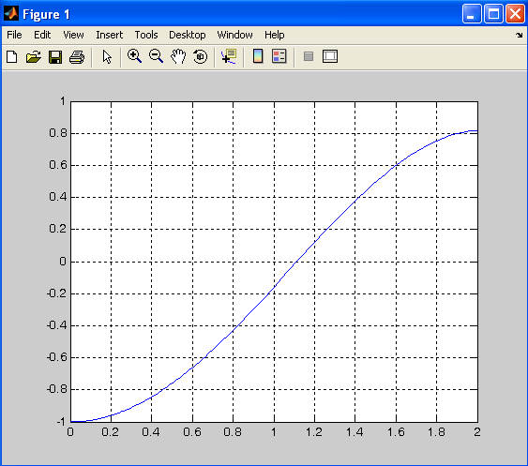

Slide 13
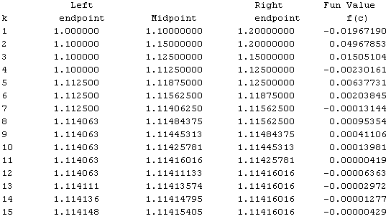
Bisection Example 2
>> [k,c,err,yc]=bisect(‘xsinm1',1,1.2,1e-5)
k = 15
c = 1.1142
err = 6.1035e-006
yc = -5.0525e-008

Slide 14
Practice Questions
Name Formula Interval AppRoot #Steps
f1 x^2-9 [0 5] _______ ______
f2 x^6-x-1 [1 2] _______ ______
f3 2*x-exp(-x) [-10 100] _______ ______

